Slide 1
JAVA BASED DIGITAL BANKING FRAUD DETECTION & SIMULATION ENGINE
Name : Gurrala Sindhuja
Batch-11 Tech Stack : Java version 8, Springboot with restAPI, Postman, Thymeleaf

Slide 2
Problem Statement
Rapid growth of digital banking channels such as online payments, mobile banking, card transactions, UPI, and international transfers
Increase in financial fraud activities alongside digital transaction growth
Common fraud types include card theft, phishing, account takeover, and unauthorized location-based transactions
Traditional banking fraud detection systems rely mainly on manual checks and static rule-based logic
Existing methods are slow, not scalable, and unable to detect complex or evolving fraud patterns
Banks require a system that can detect fraud in real time during transactions
Need for a hybrid approach that combines rule-based detection with intelligent machine learning models
Requirement for a simulation engine to generate transactions and test fraud detection accuracy before real deployment

Slide 3
Objectives
Build a real-time digital banking fraud detection system
Detect anomalous transaction behavior automatically
Identify unusual patterns in amount, location, and frequency
Combine rule-based detection with machine learning models
Classify transactions as Normal, Suspicious, or Fraud
Generate risk scores for every transaction
Provide a simulation engine to create realistic fraud scenarios
Develop a monitoring dashboard for fraud analytics
Visualize fraud trends, transaction statistics, and risk levels
Enable API-based integration with external banking systems
Design a scalable and modular fraud detection architecture
Support faster and more accurate fraud decision making

Slide 4
Key features of the System
Real-time transaction processing and fraud evaluation
Hybrid fraud detection using rule-based and machine learning models
Automatic risk score calculation for every transaction
Classification of transactions into Normal, Suspicious, and Fraud
Fraud logging and tracking for suspicious activities
Transaction simulation engine for testing fraud scenarios
REST API gateway for external system integration
Analytics module for fraud statistics and summaries
Location-based fraud detection logic
Rapid transaction pattern detection
High-amount transaction monitoring
Dashboard support for viewing transactions and fraud reports
Modular architecture for easy upgrades and feature additions
Scalable design suitable for real-world banking environments
Support for future ML model integration and cloud deployment

Slide 5
Backend Technologies
Java used as the core programming language for building the backend logic
Spring Boot used to create RESTful APIs and manage the application structure
Spring MVC used to implement the layered architecture and controller-service-repository pattern
Spring Data JPA used for database interaction and ORM-based data handling
Hibernate used as the JPA implementation for entity mapping and persistence
MySQL used as the relational database to store transactions and fraud records
REST APIs used for communication between frontend, external systems, and backend services
Maven used for dependency management and project build automation
JSON used as the data exchange format between client and server
Embedded Tomcat server used to run the Spring Boot application locally or in deployment

Slide 6
System Architecture Type
The system follows a layered architecture to separate different responsibilities of the application.
It uses the MVC (Model–View–Controller) design pattern to organize the code structure clearly.
The controller layer handles incoming HTTP requests from the frontend or external systems.
The service layer contains the core business logic, including fraud detection and simulation.
The repository layer interacts with the database using JPA.
The model layer represents the database entities such as transactions and fraud logs.
The system implements a hybrid fraud detection model that combines rule-based detection and machine learning–based risk evaluation.
Rule-based detection handles known fraud patterns such as high-amount transactions and location mismatches.
The ML plug-in is designed as an optional component that can be enabled without changing the core system.
This architecture ensures modularity, scalability, and easy integration of new fraud detection techniques.

Slide 7
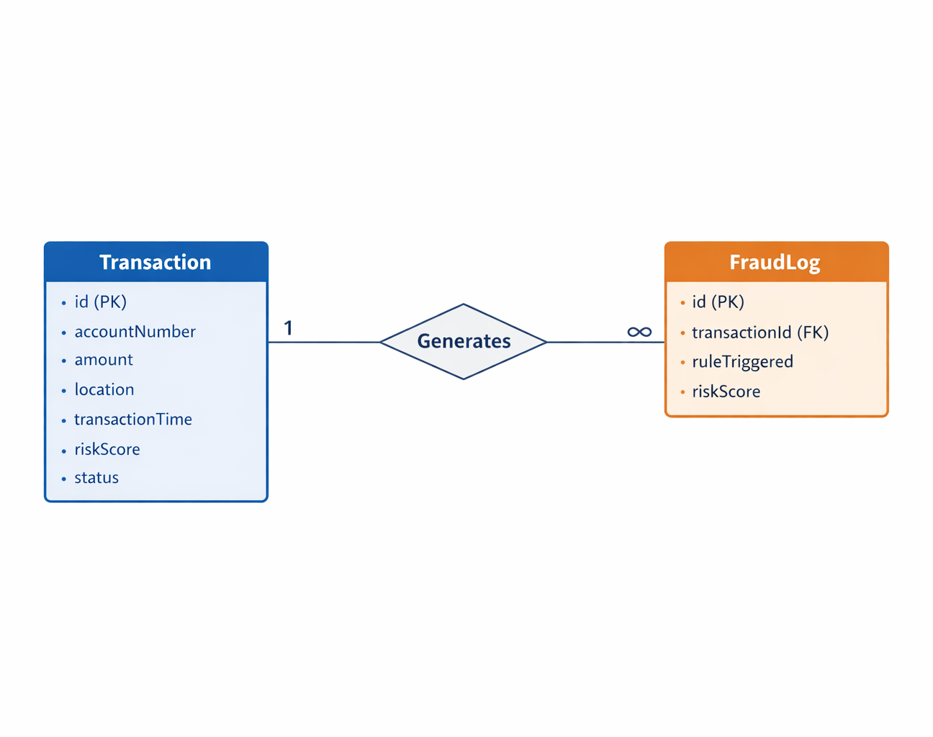
High-Level Architecture Design
The system stores and processes transaction data in a structured relational database.
The Transaction entity represents every banking transaction performed by a user.
The FraudLog entity stores fraud-related alerts generated during detection.
Each transaction is evaluated by the fraud detection engine before being stored.
If a transaction is suspicious or fraudulent, a corresponding fraud log is created.
The system maintains a one-to-many relationship between accounts and transactions.

Slide 8
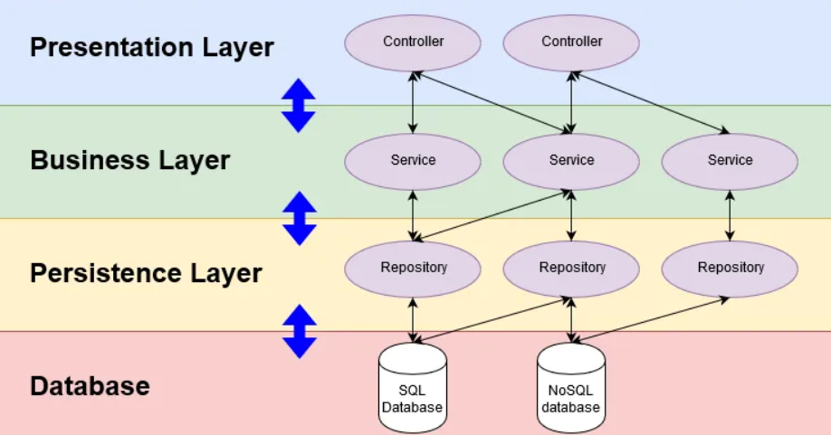
Layered Architecture
Presentation Layer
Dashboard UI
User submits transaction details
Displays fraud alerts and analytics
Controller Layer
Handles HTTP requests
Exposes REST API endpoints
Routes requests to service layer
Service Layer
Core business logic
Fraud detection rules
ML risk evaluation
Transaction processing
Repository Layer
Database interaction
Saves transactions and fraud logs
Fetches data for analytics
Database Layer
Stores transactions
Stores fraud logs
Maintains historical data

Slide 9
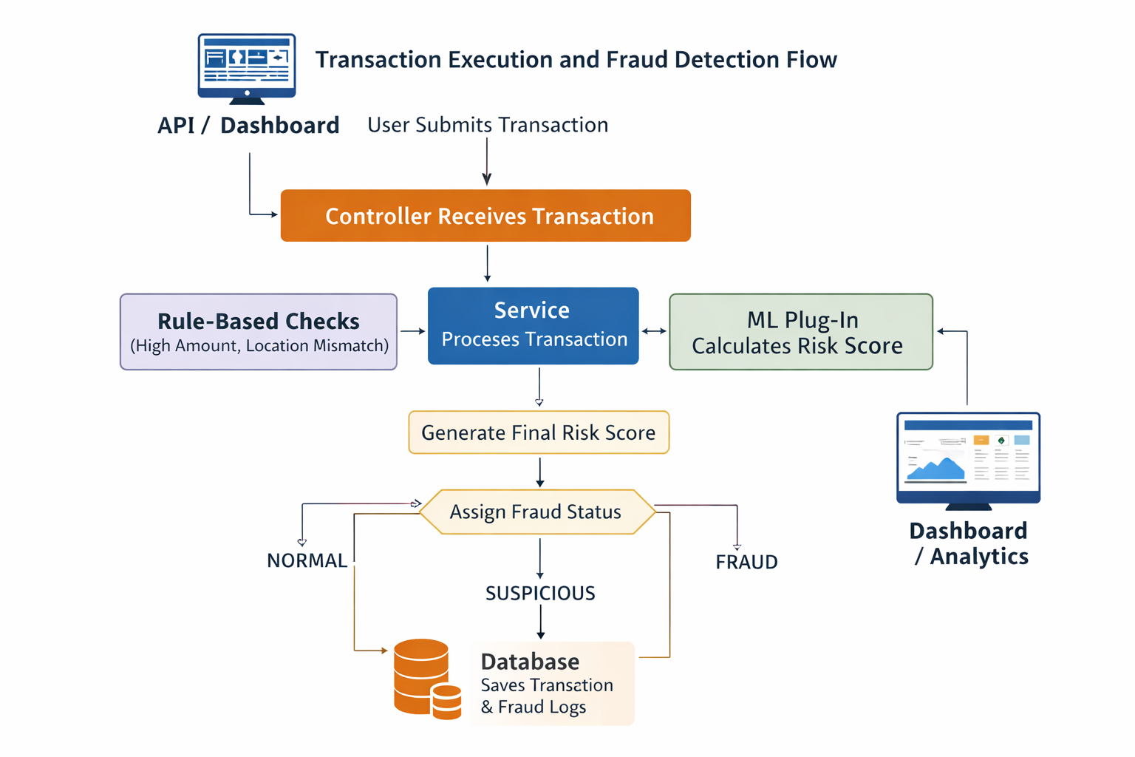
Transaction Execution and Fraud Detection Flow
The system processes every transaction through a multi-stage fraud detection pipeline.
A transaction first enters through the API or dashboard.
The transaction is passed to the service layer for processing.
The rule-based engine checks for suspicious behavior patterns.
The ML plug-in evaluates transaction risk using predictive logic.
The outputs of both methods are combined into a final risk score.
Based on the risk score, the system assigns a fraud status.
The transaction and any fraud logs are stored in the database.
The results are displayed on the dashboard and analytics modules.

Slide 10
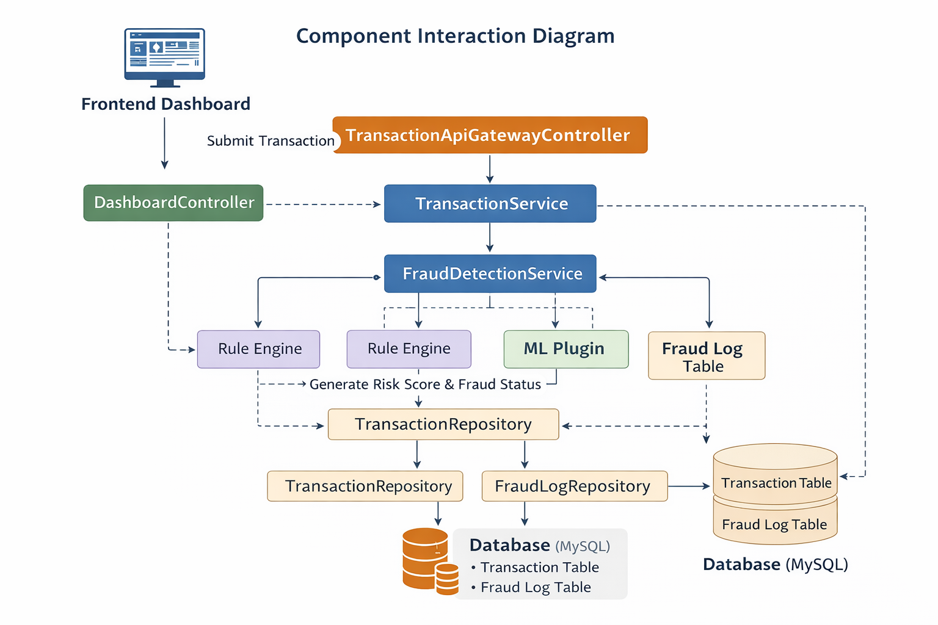
Component Interaction Diagram
Frontend dashboard collects transaction data
Controller layer receives API or UI requests
TransactionService processes and forwards to FraudDetectionService
Rule engine and ML plugin calculate risk score
Results stored in Transaction and Fraud Log tables

Slide 11
Controller Layer
Entry point for all UI and API requests
Receives transaction data from users or external systems
Validates input data
Forwards requests to service layer
Returns processed responses
Separates presentation logic from business logic
Controller Components:
TransactionController – Handles transaction creation, validation, and processing within the system.
TransactionApiGatewayController – Manages communication with external transaction and payment APIs.
FraudController – Processes fraud detection requests and flags suspicious transactions.
DashboardController – Processes fraud detection requests and flags suspicious transactions.
AnalyticsController – Generates fraud analysis insights, trends, and reporting data.

Slide 12
Service Layer
Service Layer is the core business logic layer of the application.
It sits between the Controller layer and the Repository layer.
Controllers receive requests from users or APIs and forward them to the services.
Services process the request, apply fraud detection rules, call ML models if needed, and interact with the database through repositories.
This separation keeps the code modular, reusable, and easy to maintain.
Services in the System
TransactionService – Handles transaction processing, validation, risk evaluation, and saving transaction data.
FraudDetectionService – Applies rule-based checks and ML-based risk scoring to detect fraudulent behavior.
TransactionSimulationService – Generates simulated transactions to test fraud detection scenarios.
RiskEvaluationService – Connects the system with the ML plugin to compute transaction risk scores.
AnalyticsService – Calculates fraud statistics, summaries, and location-based fraud analysis for reporting.

Slide 13
Fraud Detection Logic
The system uses a hybrid fraud detection approach that combines rule-based logic and an ML-based risk model. This ensures both fast detection and pattern recognition.
Rule-Based Detection
The system applies predefined fraud rules to every incoming transaction.
Rules Implemented :
High Amount Rule – If the transaction amount exceeds a defined threshold, risk increases.
Rapid Transaction Rule – Multiple transactions within a short time window raise the risk score.
Location Mismatch Rule – If the transaction location differs from the user’s recent location, risk increases
ML-Based Detection
An optional ML plugin evaluates the transaction.
It predicts a risk score based on patterns such as:
Location
Amount
Transaction behavior
The ML score is combined with the rule-based score.
Hybrid Risk Calculation
Final risk score is calculated as:
Final Risk = Rule-Based Score + ML Score

Slide 14
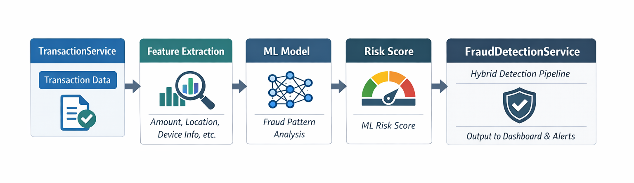
ML Plugin Architecture
Purpose: Enhances fraud detection beyond static rules.
Data Input: Receives transaction details from TransactionService.
Feature Extraction: Computes features like transaction amount, location deviation, frequency, device info, etc.
ML Model:
Trained on historical transaction data.
Detects subtle and complex fraud patterns.
Can adapt to evolving fraud trends.
Risk Score Output: Produces an additional risk score that is combined with rule-based score.
Integration:
Called by FraudDetectionService.
Works alongside rules in a hybrid detection pipeline.

Slide 15
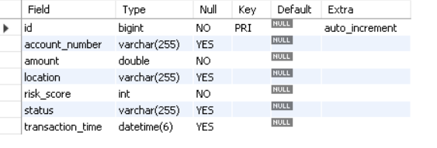
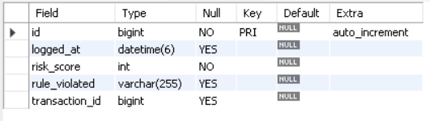
Database Design
The system uses a relational database to store transaction and fraud data.
Main tables: Transaction and Fraud_log.
The Transaction table stores all incoming banking transactions along with risk score and status.
The Fraud_log table records which fraud rule was triggered for a transaction.
Each transaction has a unique ID and is linked to fraud logs.
This structure allows tracking, auditing, and analytics of fraud events.
Tables Overview
Transaction table Fraud_log table

Slide 16
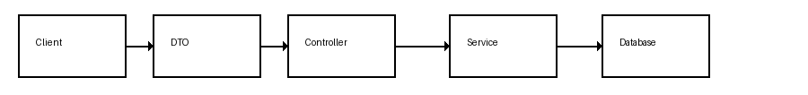
DTO and Dataflow
Purpose of DTO (Data Transfer Object)
DTOs are used to transfer data between the client and server without exposing internal database entities.
They provide a clean and secure interface for API communication.
They help in input validation and prevent unwanted fields from being stored.
DTOs reduce coupling between frontend requests and backend database structure.
TransactionRequestDTO Fields
accountNumber
Amount
Location
Data Flow Using DTO
Client sends transaction request.
Controller receives data as DTO.
DTO is converted into Transaction entity.
Service performs fraud detection.
Transaction is stored in database.
Response returned to client.

Slide 17
Fraud Status Classification
Fraud status is assigned based on the final calculated risk score. The system converts the numeric risk score into a clear status for easier decision-making.
Risk Score to Status Mapping
Risk score 0 – 29 → NORMAL
Risk score 30 – 69 → SUSPICIOUS
Risk score 70 and above → FRAUD
How Status is Assigned
FraudDetectionService calculates total risk score.
Risk score is passed to the detectStatus() method.
The method compares the score with predefined thresholds.
Based on the range, the system assigns:
NORMAL
SUSPICIOUS
FRAUD
The status is stored along with the transaction.
Purpose of Classification
Helps banks take quick decisions.
Reduces manual monitoring effort.
Enables automatic alerts for suspicious and fraud cases.
Improves real-time fraud response.

Slide 18
Fraud Rate Calculation and Fraud Percentage
Fraud rate helps measure how many transactions in the system are marked as fraud. It gives a quick overview of the system’s fraud activity and detection performance.
Fraud Rate Formula
Fraud Rate (%) = (Number of Fraud Transactions ÷ Total Transactions) × 100
Example Calculation
Total transactions: 100
Fraud transactions: 12
Fraud rate = (12 ÷ 100) × 100 = 12%
How It Is Calculated in the System
AnalyticsController calls analytics service.
System fetches:
Total number of transactions.
Number of transactions with status = FRAUD.
Fraud percentage is calculated using the formula.
Result is returned through analytics API.
Why Fraud Rate Is Important
Shows overall fraud trends.
Helps banks monitor system effectiveness.
Useful for dashboards and reports.
Helps compare performance over time.

Slide 19
Need for Transaction Simulation
Real banking fraud data is limited and highly sensitive.
Testing fraud detection on real customer data is risky and restricted.
Simulation allows safe generation of realistic transaction scenarios.
Helps test fraud detection rules under different conditions.
Enables performance testing with large volumes of transactions.
Allows developers to create specific fraud patterns for validation.
Useful for training and evaluating machine learning models.
Helps identify weaknesses in fraud detection logic.
Reduces dependency on real-world banking systems during development.
Supports continuous testing and system improvements.

Slide 20
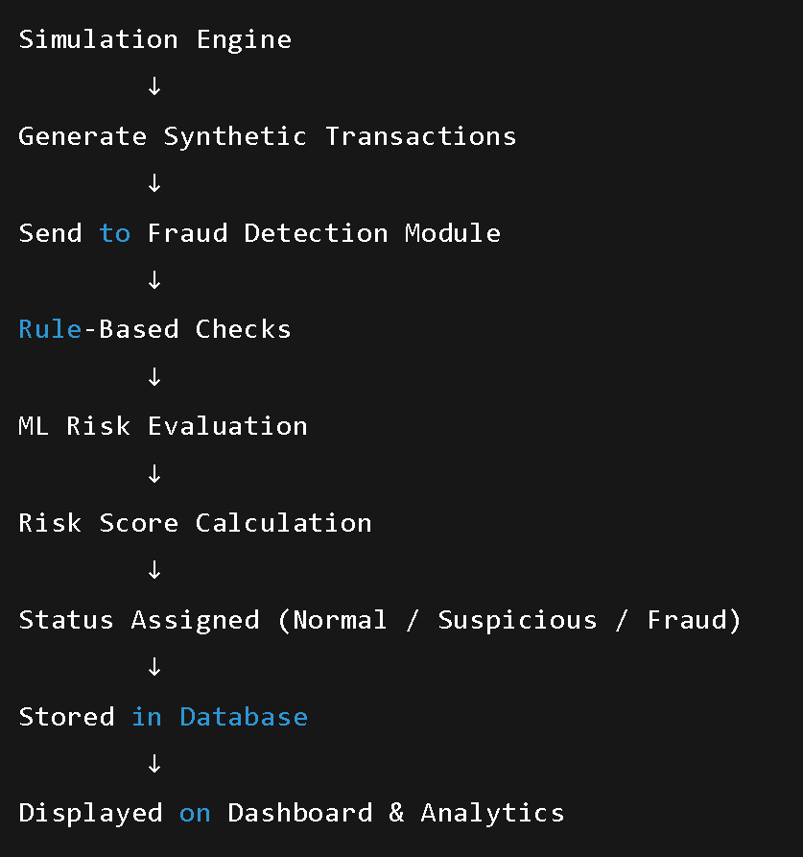
How Simulation Works
Simulation engine generates synthetic banking transactions.
Each transaction includes account number, amount, and location.
System creates both normal and suspicious transaction patterns.
Transactions are automatically sent to the fraud detection module.
Rule-based engine evaluates each simulated transaction.
ML plug-in (if enabled) adds additional risk evaluation.
Risk score is calculated and fraud status is assigned.
All simulated transactions are stored in the database.
Results are visible on dashboard and analytics APIs.
Simulation helps test system behavior under different fraud scenarios.

Slide 21
Benefits of Simulation
Enables safe testing without using real customer data.
Helps validate fraud detection rules under multiple scenarios.
Allows generation of both normal and fraudulent transactions.
Improves system reliability before real-world deployment.
Supports stress testing with high transaction volumes.
Helps measure fraud detection accuracy.
Useful for training and evaluating ML models.
Reduces dependency on external banking systems.
Speeds up development and testing cycles.
Provides controlled environment for experimenting with new fraud strategies.

Slide 22
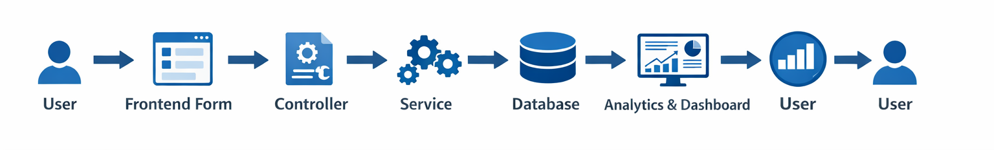
Step-by-Step Execution
User enters transaction details via the frontend form.
Form submits request to TransactionController (/transaction/create) Controller layer receives request and validates input.
Service layer processes the transaction:
Assigns risk score based on rules and ML plugin.
Checks for fraud patterns.
Updates Transaction table.
FraudController logs any triggered rules in FraudLog table.
AnalyticsController updates summaries and dashboards.
DashboardController fetches transaction and fraud data for visualization.
User can view transaction status: Normal, Suspicious, or Fraud.
System can simulate transactions using SimulationService to test fraud detection logic.

Slide 23
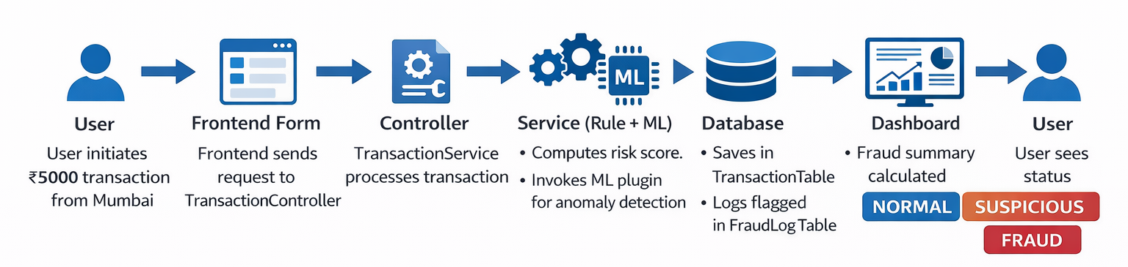
Example Execution Scenario
User initiates a transaction of ₹5000 from Mumbai.
Frontend sends the transaction request to TransactionController.
TransactionService processes the transaction:
Computes risk score based on rules.
Invokes ML plugin for anomaly detection.
Transaction is saved in Transaction Table; flagged transactions logged in FraudLog Table.
Analytics module calculates fraud summary and updates Dashboard.
User can see transaction status: NORMAL, SUSPICIOUS, or FRAUD.
System simulates multiple transactions to validate detection logic.

Slide 24
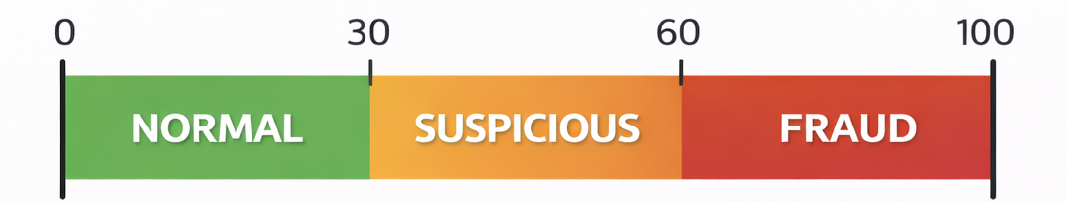
Risk Threshold Logic
NORMAL: Transactions within standard limits and matching usual behavior patterns.
SUSPICIOUS: Transactions slightly outside expected patterns, unusual location, or amount above normal range.
FRAUD: Transactions violating multiple rules, unusual location, high-risk amount, or flagged by ML plugin.
Risk Assessment Logic:
Combines rule-based risk scoring and ML anomaly score.
Final status is assigned based on aggregated risk score thresholds.
Allows real-time detection with minimal false positives.

Slide 25
The Real Banking Comparison
Traditional banks rely on manual verification and static rule checks.
Manual methods are time-consuming and prone to human error.
Limited ability to analyze large volumes of transactions in real time.
Modern digital banking requires real-time fraud detection for online payments, UPI, cards, and international transfers.
Our system provides:
Hybrid approach: Rules + ML for smarter detection.
Simulation engine: Test fraud scenarios safely.
Dashboard & analytics: Quick insights and monitoring.
Real-world benefit: Banks can prevent financial losses and improve customer trust.

Slide 26
Hybrid Fraud Detection Strategy
Rule-Based Detection:
Uses predefined rules to flag suspicious transactions.
Quick and interpretable.
Effective for known fraud patterns.
ML-Based Detection:
Learns from historical transaction data.
Can detect new, complex, and subtle fraud patterns.
Continuously improves as more data is processed.
Hybrid Approach Benefits:
Combines speed and interpretability of rules with adaptability of ML.
Reduces false positives and improves detection accuracy.
Ensures real-time monitoring while adapting to evolving fraud tactics.

Slide 27
Advantages & Limitations
Advantages:
Real-time fraud detection.
Combines rule-based and ML approaches for higher accuracy.
Safe simulation of transactions for testing.
Scalable and adaptable to evolving fraud patterns.
Dashboard and analytics provide actionable insights.
Reduces financial losses and improves customer trust.
Limitations:
Initial setup requires historical data and rule definitions.
ML models need continuous training and monitoring.
May require higher computational resources for large-scale transactions.
False positives can still occur for novel patterns.
Integration with real banking systems may need extra security audits.

Slide 28
Scalability
The system is designed to handle growing transaction volumes efficiently.
Can be deployed on cloud platforms (AWS, Azure, GCP) for high availability.
Supports distributed processing using tools like Kafka for real-time transaction streaming.
Can scale horizontally by adding more application and database instances.
ML plugin can be scaled independently for high-throughput anomaly detection.
Simulation engine can generate large datasets without affecting production systems.
Modular architecture ensures future enhancements can be integrated without major redesign.

Slide 29
Future Enhancements
Integrate advanced ML models like deep learning for better anomaly detection.
Add real-time alerts via SMS, email, or push notifications.
Implement dynamic risk scoring based on evolving fraud patterns.
Integrate additional data sources (geolocation, device fingerprinting) for more accurate detection.
Enable multi-bank integration for cross-bank fraud monitoring.
Enhance dashboard analytics with predictive insights and trend analysis.
Use cloud-native microservices for better modularity and scalability.
Introduce automated feedback loops to improve ML model accuracy over time.
Develop mobile app integration for real-time transaction monitoring by users.

Slide 30
Conclusion
Successfully developed the Digital Banking Fraud Detection and Simulation Engine.
Provides real-time fraud monitoring for banking transactions.
Implements a hybrid approach combining rule-based checks and ML-based detection.
Simulation engine allows safe testing of various fraud scenarios.
Dashboards and analytics provide actionable insights on transaction trends and fraud patterns.
Risk scoring and classification enable clear transaction status: Normal, Suspicious, or Fraud.
System is scalable and can be deployed on cloud platforms with high throughput.
Future enhancements include advanced ML models, real-time alerts, multi-bank integration, and predictive analytics.
Ensures accuracy, reliability, and adaptability, aligning with real-world banking needs.

